Slide 1
Artificial Intelligence Journal projects
Cite : https://inst.eecs.berkeley.edu/~cs188/sp23/
Mentor : Dr .C.K Narayanan
Team :
Vijay sri vaikunth (112101060)
Amithabh A(112101004)

Slide 2
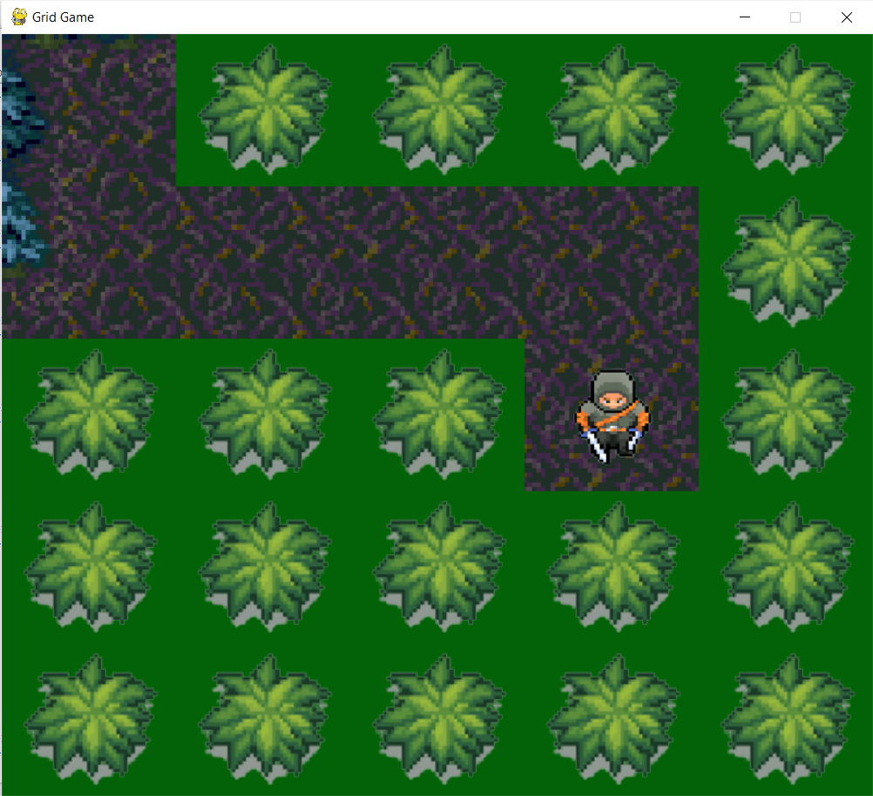
Project Abstract
The aim of the project is to design a logical game and an user interface for the game, and provide various implementation of AI strategies .
This would then help the student to grasp a better understanding of AI concepts when they try to implement their own strategies and see how the agent reacts.

Slide 3
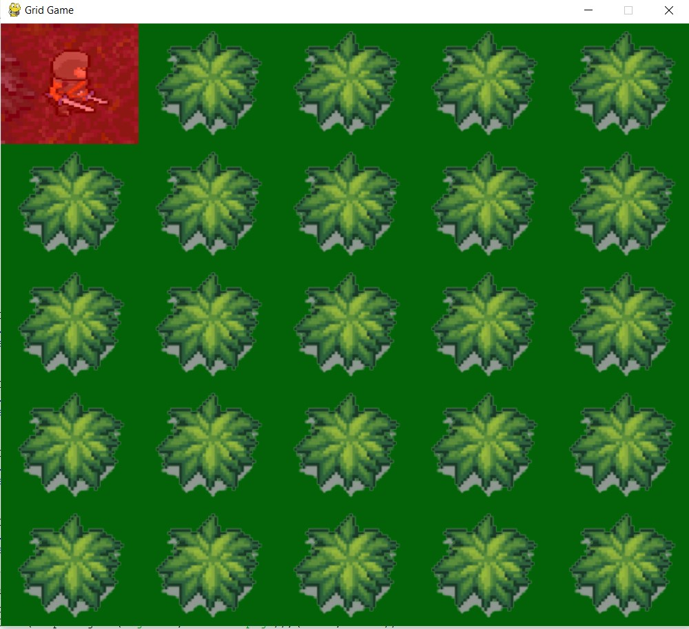
Classic Game Rules :
The classic game designed for project purposes is a logical game named dungeon.
This game allows the player to control an agent (the character) whose aim is to find the treasure hidden within the cave
But the cave is filled with traps , lions and bushes that hides these that prevent the agent from moving freely and the only way for us to identify them is through indicators.

Slide 4
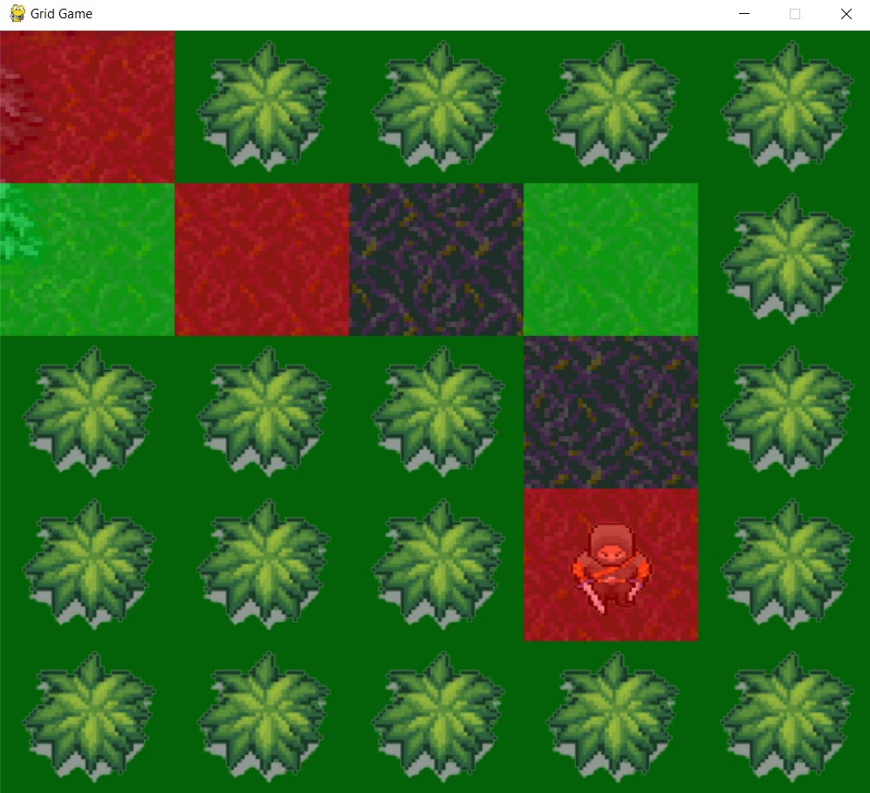
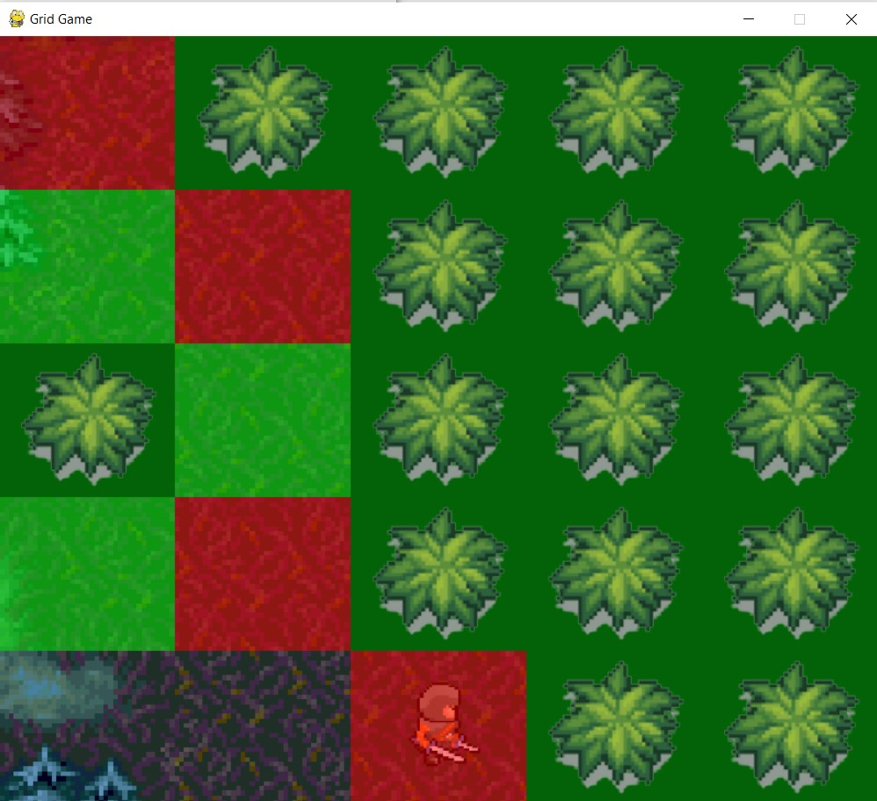
Indicators:
Roar (Red) : Indicates presence of lion in adjacent blocks
Stink (Green) : Indicates presence of pit trap in adjacent blocks
No indicator : all adjacent blocks are safe

Slide 5
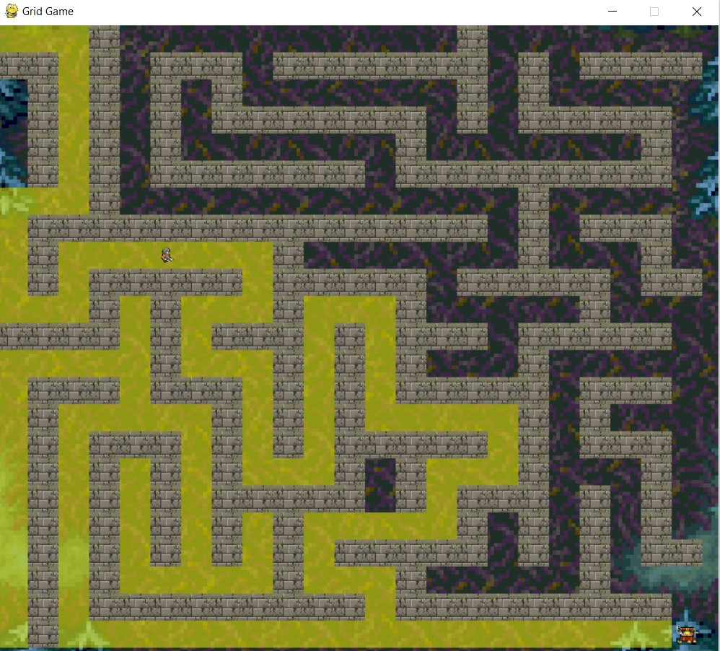
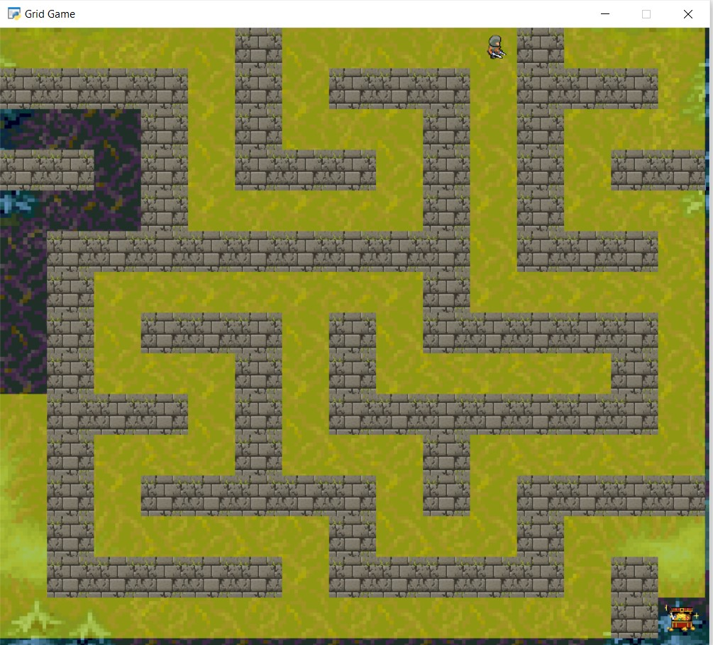
Project 1 : Classical Search
In this module , we have designed some functions within the search.py file where students can write down their implementation of search strategies such as Depth-first-search, Breadth-first-search , Uniform-cost-search and A*-search.

Slide 6
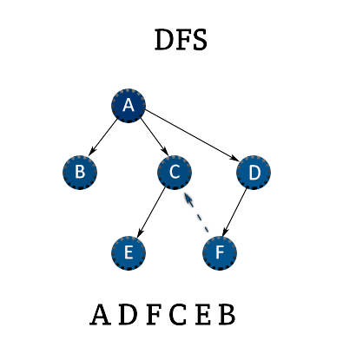
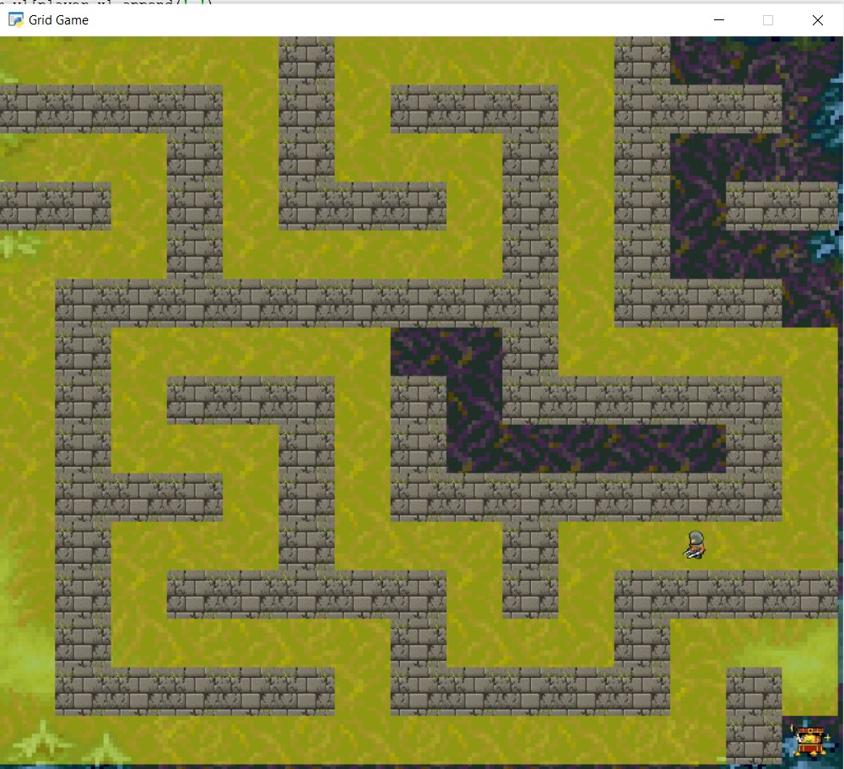
Depth-first-search :
In this strategy we Expand deepest unexpanded node first.
For the implementation of this search, we use a LIFO (Last in first out) queue – a stack , where for each nodes successors will be at first.

Slide 7
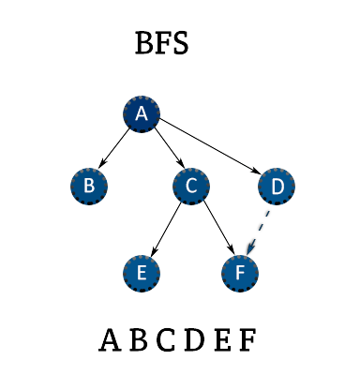
Breadth-first-search :
In this strategy we Expand shallowest unexpanded node first.
For the implementation of this search, we use a FIFO (Last in first out) queue, where for each nodes successors will be pushed at last.

Slide 8
Uniform-cost-search :
In case of uniform cost search and A* search , we associate each states with the functions:
f(n) = Total estimated cost to reach goal state from start state via state n.(evaluation fn)
g(n) = Total estimated cost to reach state n from start state w.r.t cost fn.
h(n) = Total estimated cost to reach goal state from state n (a.k.a heuristic)
UCS expands least cost (g(n)) expanded nodes and its implemented with the help of priority queues (to order in w.r.t cost)

Slide 9
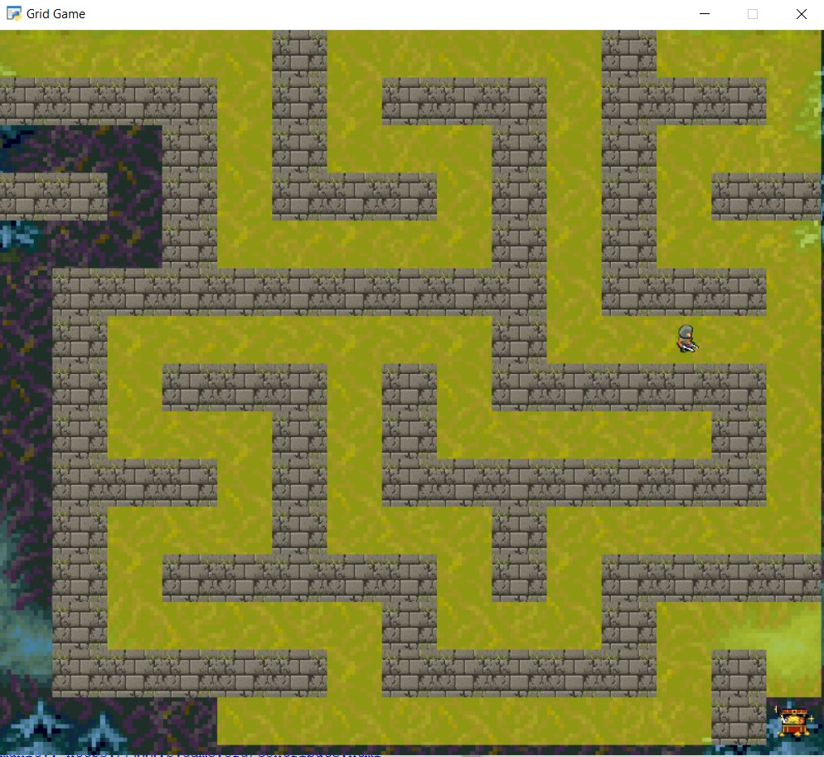
A*- Search :
A* search expands least cost (f(n)) expanded nodes and its implemented with the help of priority queues based on evaluation fn. The idea is that it avoids expanding already expensive paths.
A*search with Manhattan distance as heuristic:

Slide 10
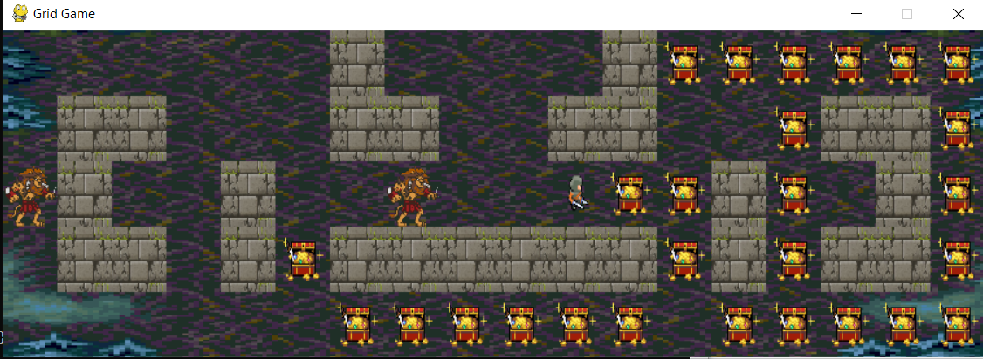
Project 2 : Adverserial Search
In this module, we will deal with the lions actively trying to pursue the player, making this a zero sum game : only one party can win – player or lions.
Player being the one who we need to win we call him max agent, and we call lion to be min agents.
We implement minimax algorithm to decide the action that agent is supposed to take at each state

Slide 11
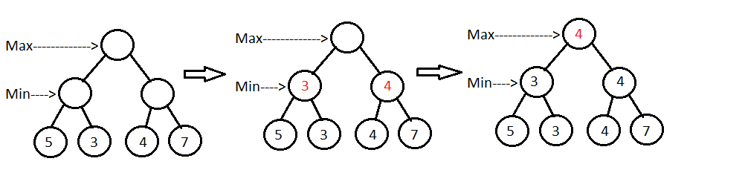
Minimax Algorithm
In minimax algorithm , the max agent is the one that tried to maximize the utility value and min agent tries to minimize it. The value of utility function at each node is found by augmenting the utility value of leaf node that can be reached from that state
In this implementation of adversarial search , we programmed the lions to always greedily choose best action based on Manhattan distance.

Slide 12
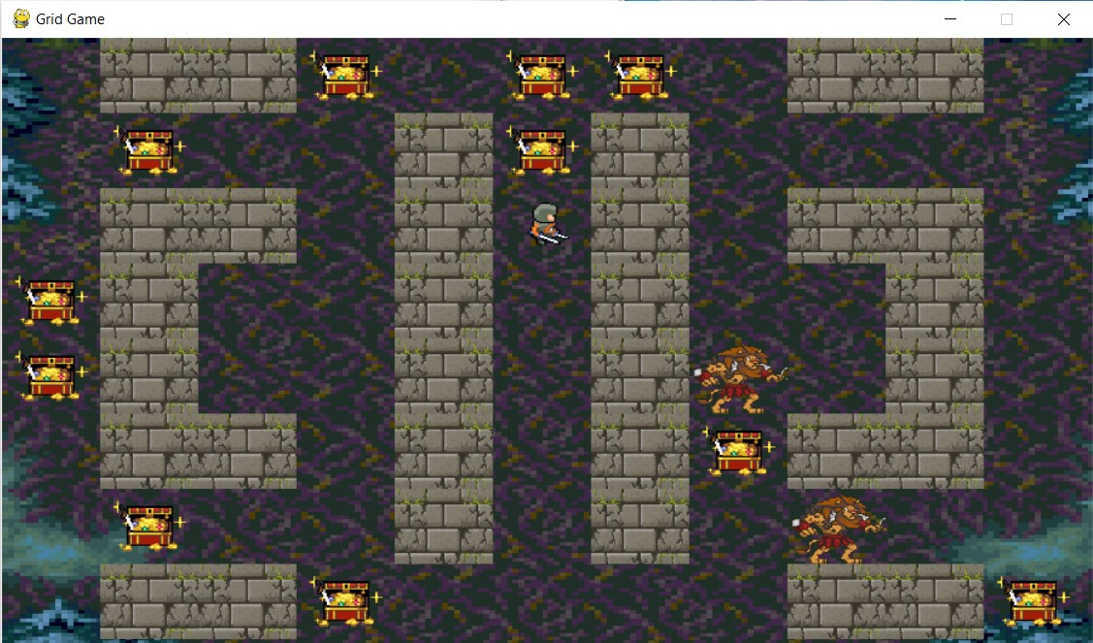
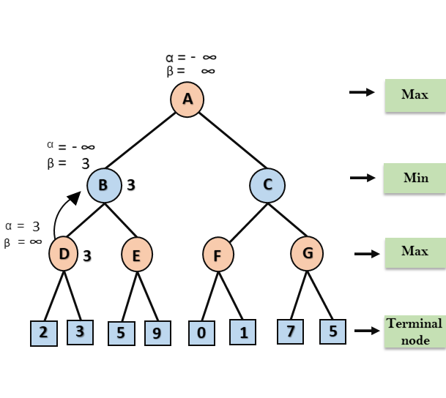
Alpha-Beta pruned minimax :
There are two ways to make the minimax algorithm more efficient : alpha beta pruning and Expecti-minimax.
In alpha beta pruning, instead of going through all the leaf nodes and branches of the game search tree, we prune some of the branches by never checking them.
We do this by book-keeping the largest observed value in alpha and least observed utility value in beta.

Slide 13
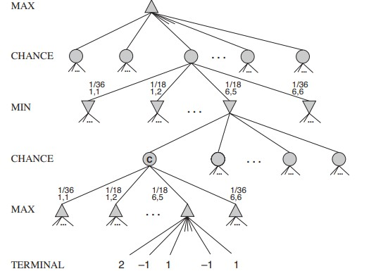
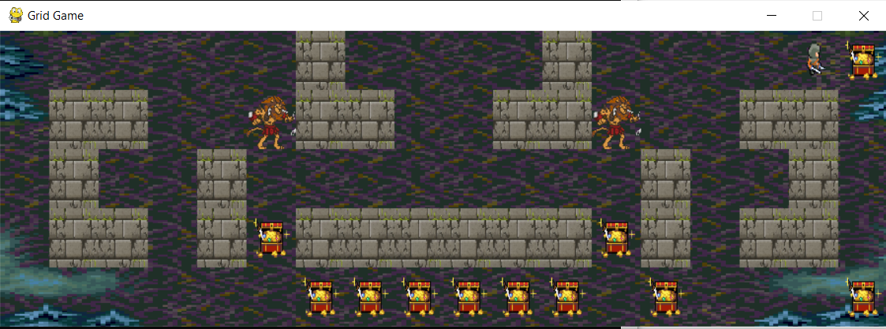
Expecti-minimax
Expecti-minimax is yet another method of minimax strategy to increase its efficiency. In expecti-minimax we add an additional layer to the game search tree – the chance nodes.
The value of each chance node is weighted sum of utility values of all nodes below it with the probability of reaching those nodes.
This helps the algorithm to avoid exploring all the nodes by just going through the nodes that has high chance value.

Slide 14
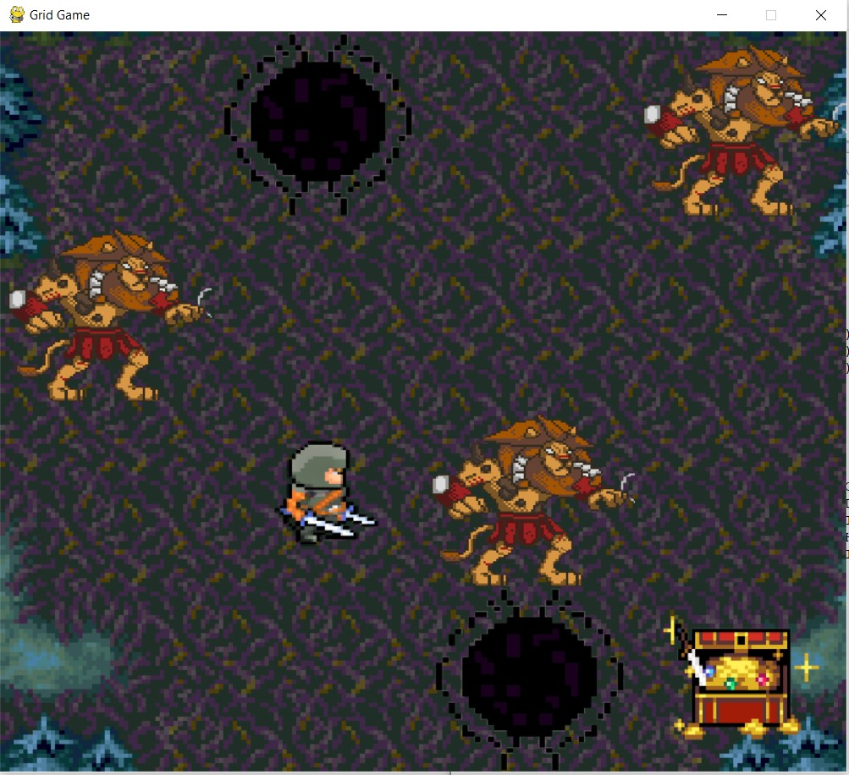
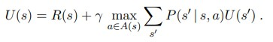
Project 3 : Reinforcement Learning
In this module of the project , we designed a class describing a Markov decision processes , to help students implement and learn about the reward based learning .
This module mainly concentrates on two aspects of Reinforcement learning : Value iteration, Q-learning.
Bellman Equation :

Slide 15
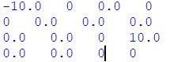
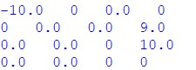
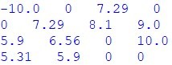
Value iteration :
In this module, the game is portrayed as a Markov decision process.
Each state of the game is associated with a reward, transition probability , discount, exploration rate.
Using these provided functions students are expected to implement value iteration where the value of each state is updated using bellman equation on each iteration. After certain number of iterations the value of each state will be evaluated to get a better understanding of bellman equations
Values after 1 iteration
Values after 2 iterations
Values after 100 iterations

Slide 16
Q-learning :
In value iteration we have seen that the agent uses bellman equation on the MDP to form a policy through iteration rather than trials.
Unlike value iteration, the agent uses Q-learning to learn through experience, based on the rewards attained in each episode to form a policy for each state.
Equation used to update Q-values for each state:

Slide 17
Policy evaluation
In both of these following methods we implement a function to evaluate the policy given as the result of value iteration or Q learning algorithm.
This helps the students to see how an agent behaves on following the policy produced by these algorithms.

Slide 18
THANK YOU

